Slide 1
Secure data Hiding in Images using steganography
CAPSTONE PROJECT
Presented By
Student Name : Yogeshwar Prabhu
College Name & Department : Srinivas Institute of Technology,
Computer Science and Business Systems

Slide 2
OUTLINE
Problem Statement
Technology used
Wow factor
End users
Result
Conclusion
Git-hub Link
Future scope

Slide 3
Problem Statement
In today's digital world, protecting sensitive information is a growing concern. While encryption secures data by making it unreadable, it also highlights the presence of confidential communication. This project solves the challenge of discreet message transmission by leveraging steganography—the technique of embedding information within ordinary images. By seamlessly hiding text within digital images, this approach ensures secure communication without drawing attention. The developed application features a user-friendly GUI, enabling easy encoding and decoding of messages while preserving the original image quality, making the process both highly secure and practically undetectable.

Slide 4
Technology used
📌Libraries & Platforms
Libraries:
OpenCV (cv2)
Tkinter & ttk
NumPy
Pillow
OS
Pathlib
📌Platform:
Python 3.8+

Slide 5
Wow factors
Modern Dark-Themed GUI – A sleek, professional interface with real-time status updates and a visually appealing dark theme, ensuring accessibility for both technical and non-technical users.
Dual Input System – Supports both direct text entry and file-based messages, with automatic validation to prevent data loss and ensure message compatibility with image capacity.
Enhanced Security – Implements password protection for encoding and decoding messages, ensuring confidentiality while preserving the original image quality with robust error handling.
Smart Message Processing – Optimized pixel utilization enables efficient message storage while maintaining integrity, preventing overflow, and ensuring seamless retrieval. These features blend security with usability, making it a powerful yet user-friendly steganography solution.

Slide 6
End users
Privacy-Conscious Individuals
Educational Sector
Security Professionals
Digital Rights Activists

Slide 7
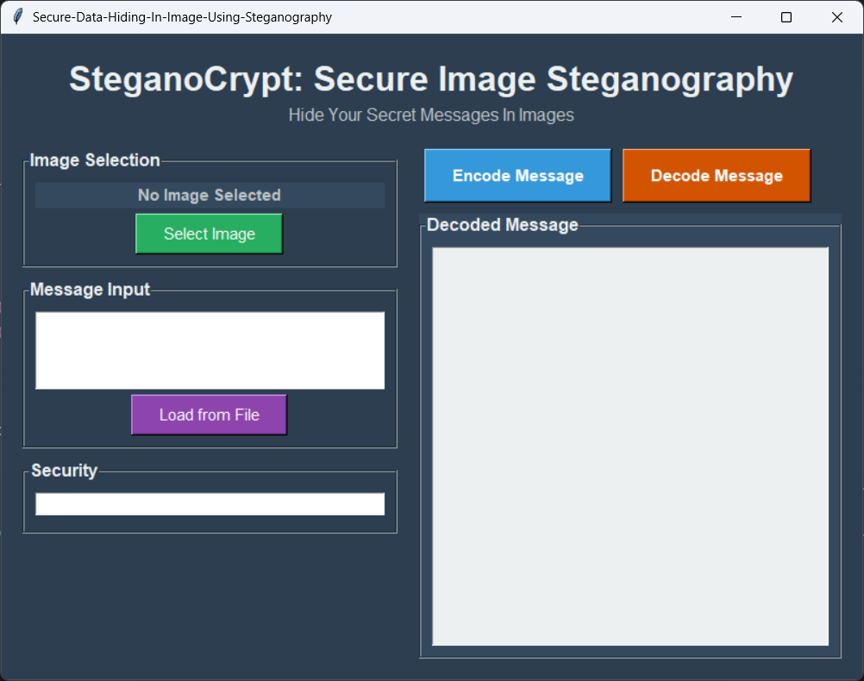
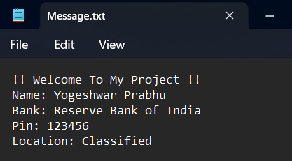
Results

Slide 8
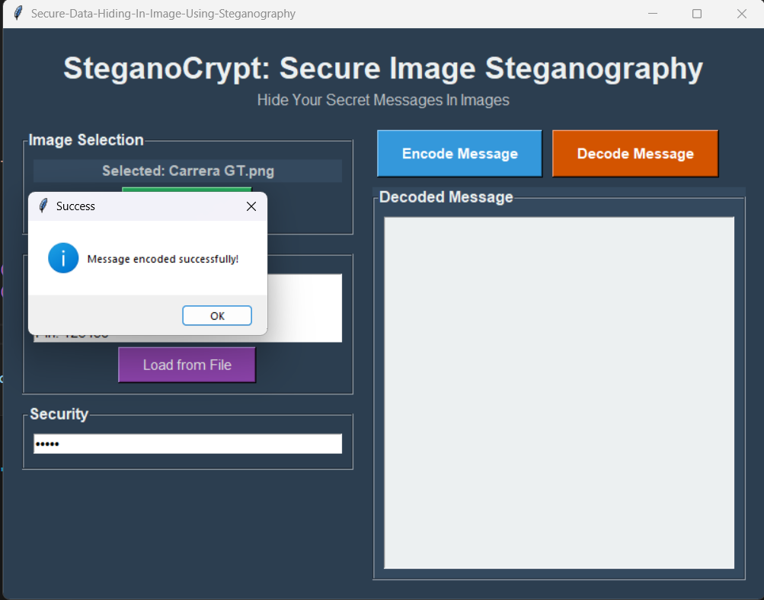
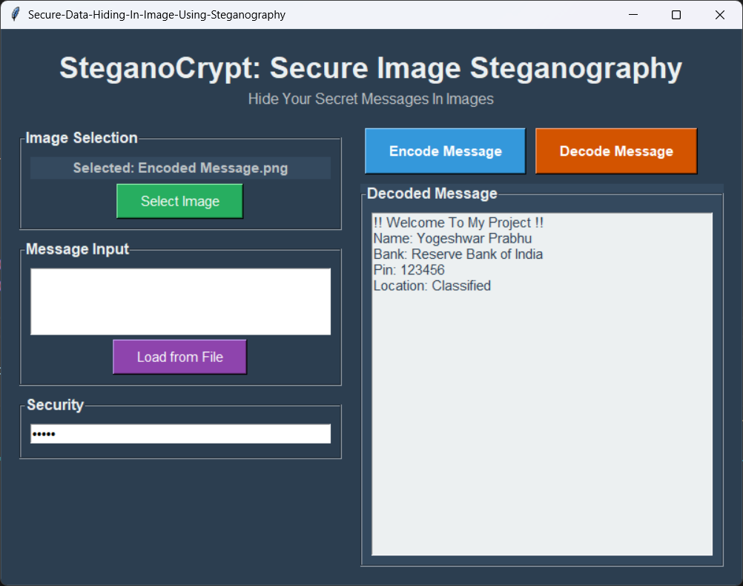
Results

Slide 9
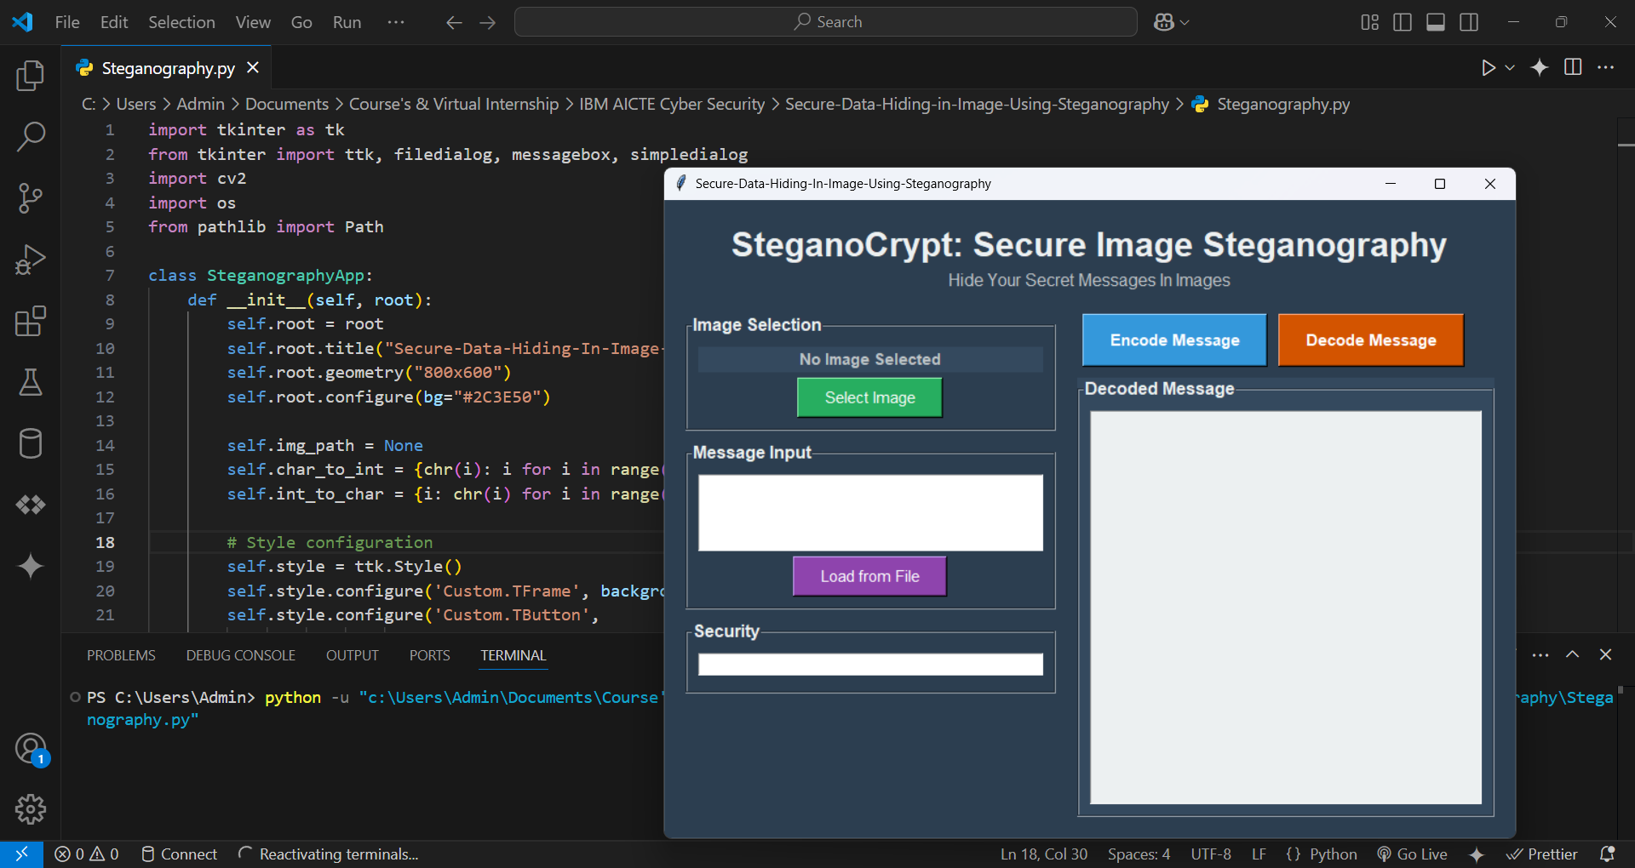
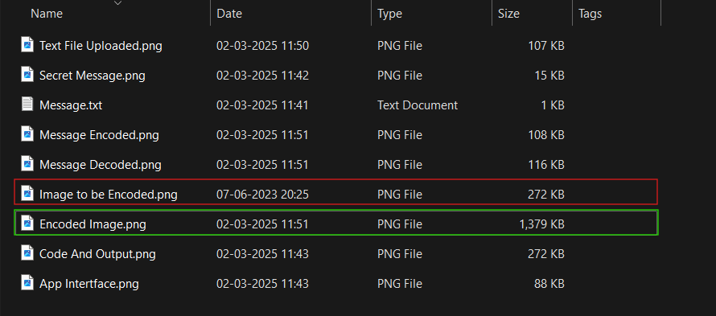
Results

Slide 10
Conclusion
This Image Steganography application successfully addresses the need for covert communication by providing a secure, user-friendly solution for hiding messages within digital images. The project achieves its core objectives by:
Security & Privacy: Successfully implementing LSB steganography with password protection, making secret messages undetectable to casual observers.
Accessibility: Creating an intuitive dark-themed GUI that makes steganography accessible to both technical and non-technical users.
Reliability: Ensuring message integrity through automatic capacity checking and efficient pixel utilization, preventing data loss or corruption.
Bridges the gap between security & usability, making covert communication easier.

Slide 11
GitHub Link
GitHub Repository : https://github.com/Yogeshwar-Prabhu/Secure-Data-Hiding-in-Image-Using-Steganography

Slide 12
Future scope
Enhanced Security : Implementation of advanced encryption algorithms (AES/RSA) alongside steganography, and support for hiding messages in audio/video files.
Advanced Features : Integration of blockchain for message verification, cloud storage support for secure image sharing, and AI-powered steganography detection resistance.
AI-Powered Detection Resistance : Making hidden messages even more secure.
Cross-Platform Development : Mobile application development (Android/iOS) and web-based version with real-time collaboration features.

Slide 13
THANK YOU

